Slide 1
8086 Inputs
+5V
VCC
MN/MX
AEN1
NC
TEST
HLDA
AEN2
CSYNC
X1
INTR
INTA
15 Mhz
8259
X2
RDY1
RESET
RESET
+5V
RDY2
F/C
8284
CLK
+5V
CLK
10K
READY
READY
RES
10 µ
NMI
8284 Crystal oscillator
HOLD
GND

Slide 2
8086
LS373
AD₀-AD₇
A₁₆-A₁₉
G
OE’
LS373
AD₈-AD₁₅
A₁₆-A₁₉
G
OE’
AD₁₆-AD₁₉/
S₆-S₃
LS373
A₁₆-A₁₉
BHE’/S₇
G
OE’
BHE’
ALE
System Bus of 8086 (Address)

Slide 3
8086
LS245
AD₀-AD₇
D₀-D₇
DIR
DIR
OE’
OE’
LS245
AD₈-AD₁₅
D₈-D₁₅
DIR
OE’
DT/R’
DEN’
MN/MX’
5V
System Bus of 8086(Data + Control)

Slide 4
ROM1E
A₀
ROM1
LS138
ROM₁
A₁₅ A₁₄ A₁₃
O₀
O₂
O₃
O₄
O₅
O₆
I₂
I₁
I₀
A₀
RAM
RAME
O₁
RAM
BHE’
ROM2
ROM2E
GND
G_{2B}
BHE’
ROM1
ROM1O
O₇
ROM₂
G_{2A} G₁
A₀
RAM
RAMO
M/IO'
GND
A₀
ROM2
ROM2O
Memory Decoder

Slide 5
ROM1E
ROM2E
RAME
A₁
A₁₁
2716_{1E}
A₁
A₁₁
2716_{2E}
A₁
A₁₁
6116_{1E}
A₀
A₁₀
D₀
D₇
D₀
D₇
A₀
A₁₀
D₀
D₇
D₀
D₇
A₀
A₁₀
D₀
D₇
D₀
D₇
WR’
RD’
RAME
WE’
OE’
CS’
RD’
ROM1E
OE’
CS’
RD’
ROM2E
OE’
CS’
ROM1O
ROM2O
ROM1E
A₁
A₁₁
2716_{1O}
A₁
A₁₁
2716_{2O}
A₁
A₁₁
6116_{1O}
A₀
A₁₀
D₀
D₇
D₈
D₁₅
A₀
A₁₀
D₀
D₇
D₈
D₁₅
A₀
A₁₀
D₀
D₇
D₈
D₁₅
WR’
RD’
RAMO
WE’
OE’
CS’
RD’
ROM1O
OE’
CS’
RD’
ROM2O
OE’
CS’
Memory Interfacing

Slide 6
A₆ A₅ A₄
74LS138
8255 CS’
ABC
Y₀
Y₁
8253(1) CS’
Y₂
8253(2) CS’
8259 CS’
Y₃
V_{CC}
E1E2E3
A₇
M/IO’
I/O Decoder

Slide 7
8255 Interface to the processor
A₁
A₀
A₂
A₁
8255 CS’
CS
8255
RD
RD
WR
WR
D₀ – D₇
D₀ – D₇
RESET from 8284
RESET

Slide 8
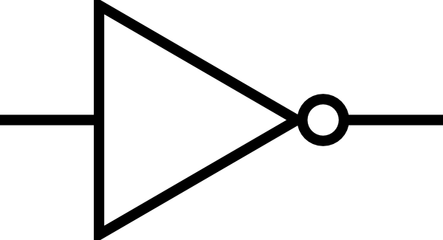
8255 Interface to the I/O devices
PA₀
i/p to lock
PA₁
Water-In Valve(Relay)
PA₂
Water-Out Valve(Relay)
Port A o/p
PA₃
Process End Buzzer
PA₄
Alarm ( Door )
PA₅
Detergent Valve(Relay)
PA₆
Alarm ( Malfunction )
PA₇
PB₀
Water Full Sensor
PB₁
Water-Empty Sensor
RESUME
PB₂
Port B i/p
PB₃
Door Sensor
PB₄
8253(1) OUT2
8255
PB₅
8253(2) OUT0
PB₆
8253(2) OUT2
PB₇
LOAD
PC₀
Port C lower i/p
PC₁
START
PC₂
PC₃
PC₄
8253(1) G2
Port C higher o/p
PC₅
8253(1) G1
PC₆
8253(2) G0
PC₇
STOP EN

Slide 9
8253 (1) Interface to the processor
D₀ – D₇
D₀ – D₇
8253 (1) CS’
CS’
8253
RD’
RD
WR’
WR
A₁
A₀
A₂
A₁

Slide 10
8253 (2) Interface to the processor
D₀ – D₇
D₀ – D₇
8253 (2) CS’
CS’
8253
RD’
RD
WR’
WR
A₁
A₀
A₂
A₁

Slide 11
2.5 MHz PCLK
8253(1)
VCC
STOP EN
CNT0
CLK₀
GATE₀
Count: 25000d
Mode 3
OUT₀
CLK₁
100Hz
CNT1
GATE₁
Count: 100d
Mode 3
1Hz
OUT₁
1Hz CLOCK
CNT2
CLK₂
GATE₂
PC₄
Count: Depends on length of wash/rinse cycle
Mode 1
OUT₂
PB₄
AGITATOR EN

Slide 12
8253(1) OUT₁
1 Hz
1 Hz CLOCK (Enabled with STOP signal)
STOP EN
8253(2)
STOP EN
CNT0
CLK₀
GATE₀
PC₆
Count: Depends on length of dry cycle
Mode 1
OUT₀
PB₅
CNT1
CLK₁
Count: 600d, Used to check for max 10 min during water in or water out.
Mode 1
GATE₁
PC₅
OUT₁
PB₆
1Hz CLOCK
CNT2
CLK₂
Count: Different counts to generate different freq
and sound in the
buzzer/alarm.
Mode 3
REVOLVING TUB EN
GATE₂
BUZZER EN
OUT₂
BUZZER FREQ

Slide 13
D₀
D₇
STOP
8259
D₀
D₇
INTR
INTA’
RD’
WR’
A₀
CS’
IR₀
to 8086
INTR
IR₁
IR₂
IR₃
IR₄
IR₅
IR₆
IR₇
INTA’
from 8086
NC
RD’
WR’
A₁
CS’
CAS₀
CAS₁
CAS₂
NC
5V
SP/EN
8259

Slide 14
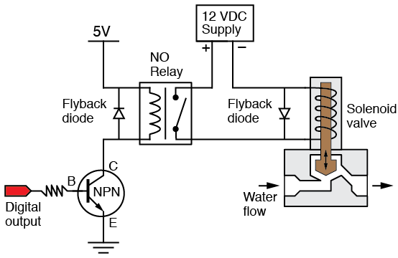
PA₂
Outside washing machine
Water-Out Enable
Water Out Relay
PA₁
Inside washing machine
Water-In Enable
Water In Relay
PA₅
Detergent compartment
Inside washing machine
Detergent Enable
Detergent Relay

Slide 15
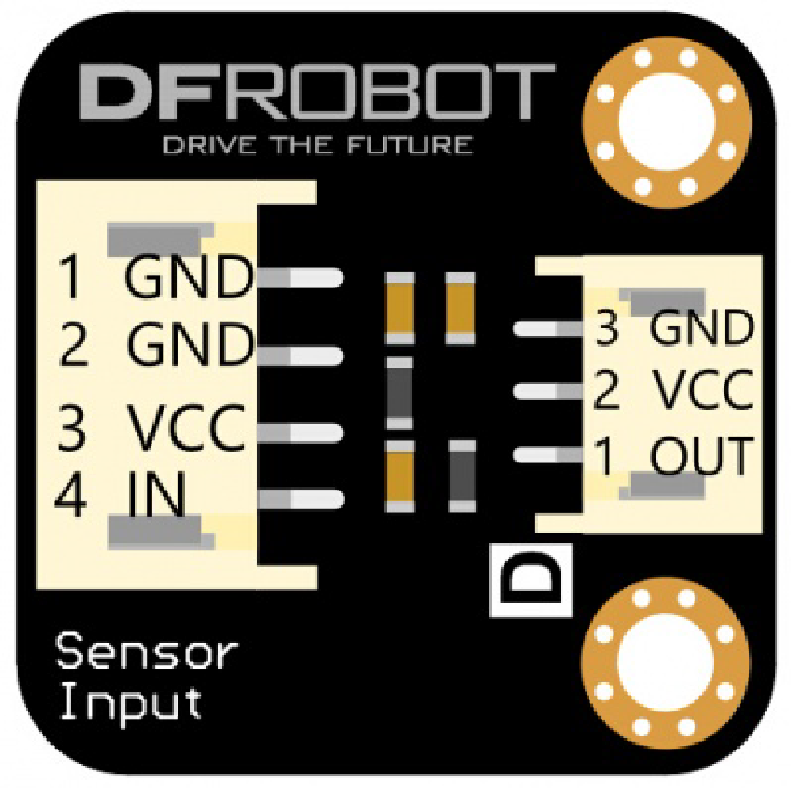
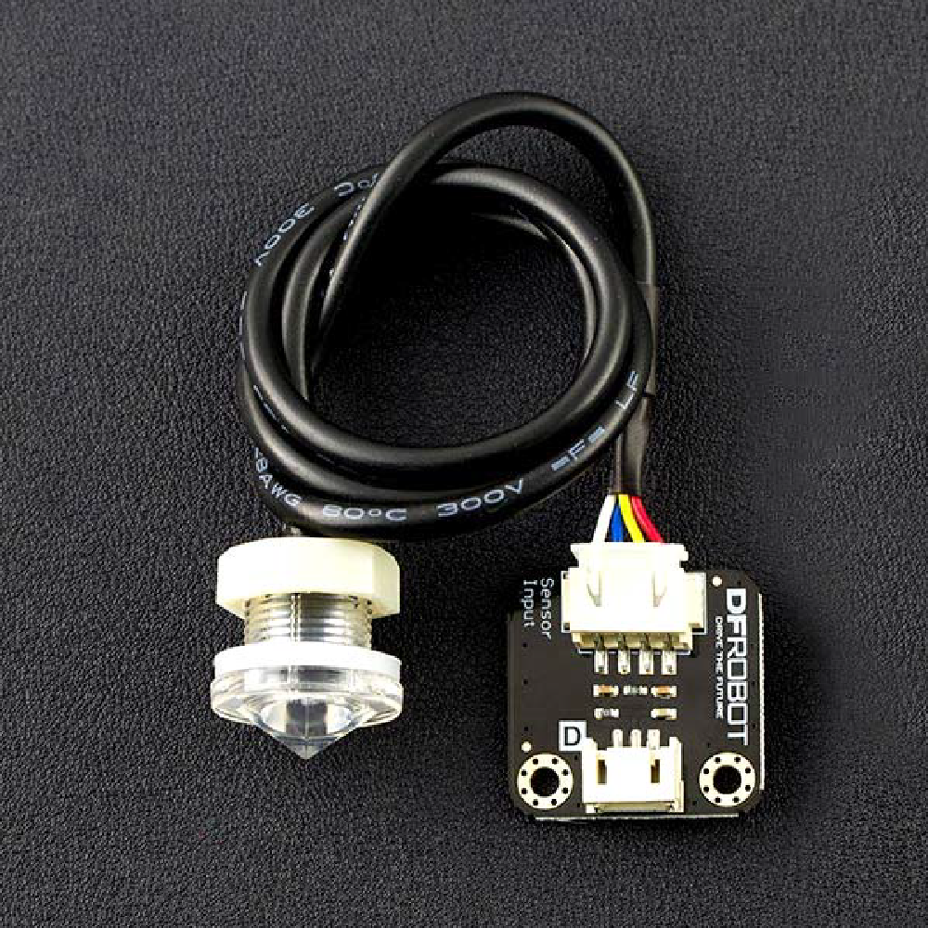
FS IR02 Converter Board
5 V
Input from Sensors
PB₀
Water Full
Water Full Sensor
5 V
Water Sensor- FS IR02
Input from Sensors
PB₁
Water Empty Sensor
Water Empty

Slide 16
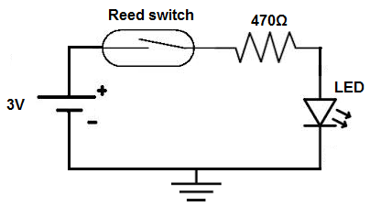
PROCESS END PA₃
ISSUE PA₆
BUZZER EN
ALARM PA₄
GND
8253 (2) OUT2
I/O
BUZZER FREQ
Vcc
BUZZER EN
Buzzer- RKI 4706
5 V
PB₃
Door Sensor
Door Sensor

Slide 17
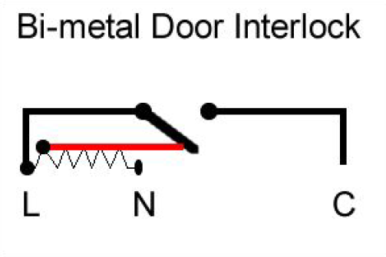
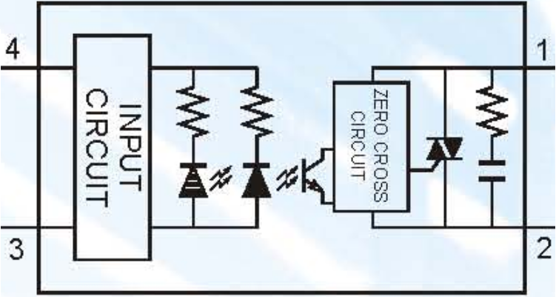
Latch for Lock
Bi-metal Door Interlock
Solid State Relay Used:
FOTEK SSR 40da
AC Neutral
GND
AC Supply
(220V)
(DC Control Signal)
PA₀
AC Live

Slide 18
Allegro Motor Driver
A4915
Motor
(Crouzet 801405)
8253 (1) OUT2
Agitator
Allegro Motor Driver
A4915
Motor
(Crouzet 801405)
8253 (2) OUT0
Revolving Tub

